Slide 1



377 Operating Systems
Join on Zoom if you are remote (see website for link).
Introduction to Operating Systems

Slide 2
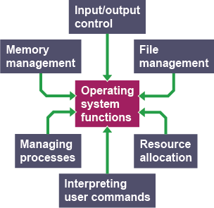
Virtualization
The primary mechanism the OS uses to accomplish this is virtualization.
The OS takes a physical resource (e.g., processor, memory, disk) and transforms it into a more general, powerful, and easy-to-use virtual form of itself.
Thus, we sometimes refer to the operating system as a virtual machine.

Slide 3
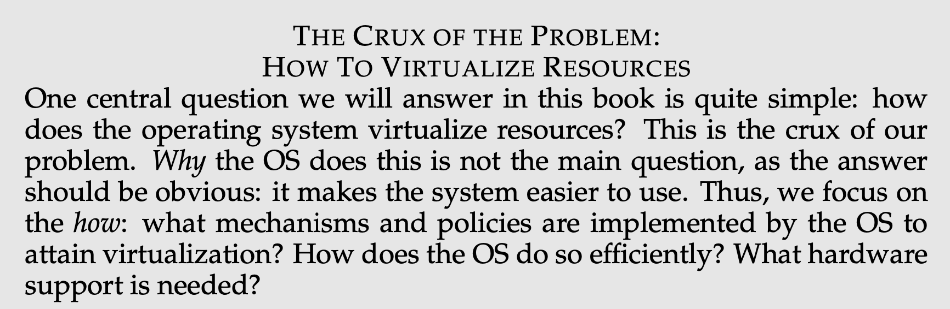
How to Virtualize Resources

Slide 4
How to Virtualize Resources

Slide 5
How to Virtualize Resources

Slide 6
How to Virtualize Resources

Slide 7
How to Virtualize Resources

Slide 8
How to Virtualize Resources

Slide 9
How to Virtualize Resources

Slide 10
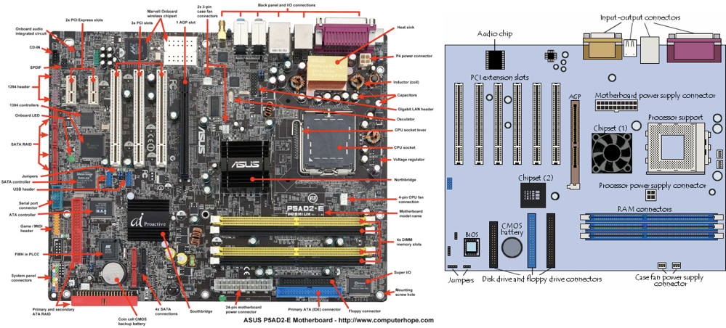
What are we Virtualizing?
Notes:
Picture of a motherboard/logicboard
Point out CPU, RAM slots, ports (ethernet for instance), USB ports
PCI slots for additional components

Slide 11
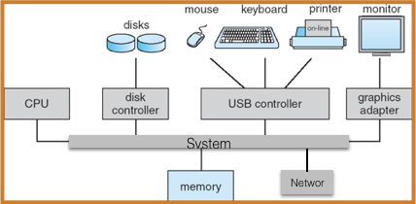
Generic Architecture
CPU: performs the actual computation,
multiple “cores” are common

Slide 12
Generic Architecture
I/O devices: terminal, disks, video board,
network, printer, etc.

Slide 13
Generic Architecture
Memory: RAM containing
data and programs used by CPU

Slide 14
Generic Architecture
System Bus: communication to CPU,
memory, peripherals

Slide 15
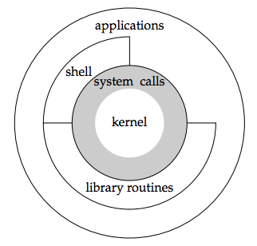
Telling the OS what to do
How do we tell an OS what to do?

Slide 16
Telling the OS what to do
We want to make use of features the virtual machine provides such as running a program, or allocating memory, or accessing a file.

Slide 17
Telling the OS what to do
To do this, the OS provides some interfaces (APIs) that you can call.

Slide 18
Telling the OS what to do
A typical OS, in fact, exports a few hundred system calls that are available to applications.

Slide 19
Telling the OS what to do
Because the OS provides these calls to run programs, access memory and devices, and other related actions, we also sometimes say that the OS provides a standard library to applications.

Slide 20
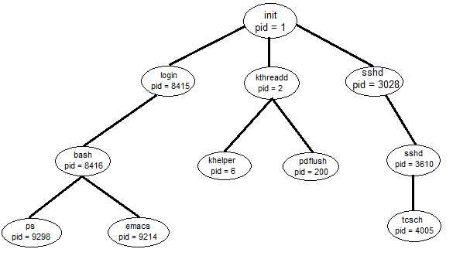
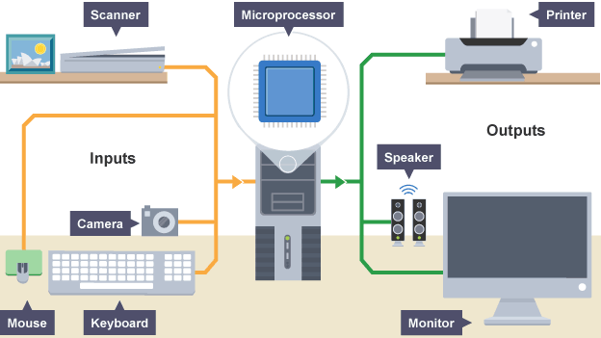
OS as a resource manager
Because virtualization allows many programs to run, concurrently accessing resources,
the OS is sometimes known as a
resource manager

Slide 21
OS as a resource manager
Each of the CPU, memory, and disk is a resource of the system.
The operating system manages those resources.
Efficiently or fairly or indeed with many other possible goals in mind.

Slide 22
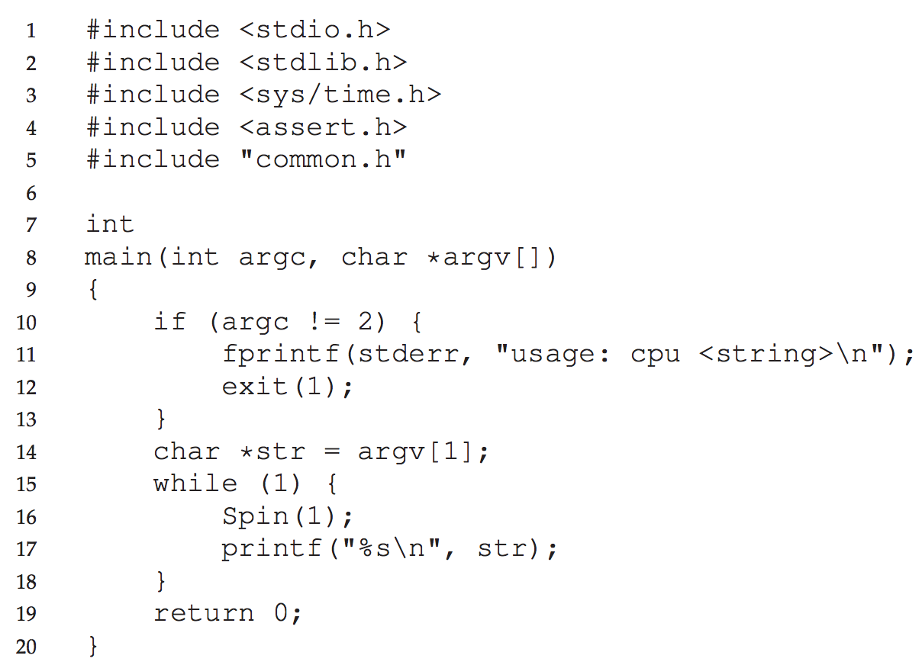
Virtualizing the CPU
Code that Loops and Prints (cpu.c)
It doesn't do much.
In fact, all it does is call Spin() and prints the program argument in a loop - forever.
Spin() repeatedly checks the time and returns after a second has passed.
You can find this code here: https://github.com/remzi-arpacidusseau/ostep-code
Just git clone it; then cd intro
Notes:
Download code: https://github.com/remzi-arpacidusseau/ostep-code
intro/
Demo:
./cpu A
sysctl -n hw.ncpu (shows number of CPUs)
Four could all have their own CPUs:
./cpu A & ./cpu B & ./cpu C & ./cpu D &
killall cpu
But 17 could not:
./cpu A & ./cpu B & ./cpu C & ./cpu D & ./cpu E & ./cpu F & ./cpu G & ./cpu H & ./cpu I & ./cpu J & ./cpu K & ./cpu L & ./cpu M & ./cpu N & ./cpu O & ./cpu P & ./cpu Q &
killall cpu
Explain how this is possible. Talk about the CPU being a resource manager to decide which one runs and when.

Slide 23
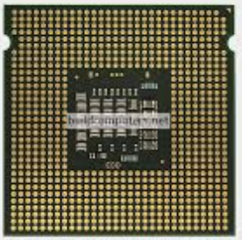
Running many programs at once
The operating system virtualizes the CPU.
We have a single resource (the CPU), but we want to run more programs that a single CPU, or even multiple CPUs, can run.
So, how does the operating system, given a limited resource, run more programs than the number of CPUs available?
The OS needs to give each program its fair share of the CPU and switch between then efficiently.
nproc - Linux command that shows the number of processing units.
What happens when we run each of the following commands:
$ ./cpu A
$ ./cpu A & ./cpu B & ./cpu C & ./cpu D &
What if we were to run $(nproc)+1 cpu programs?

Slide 24
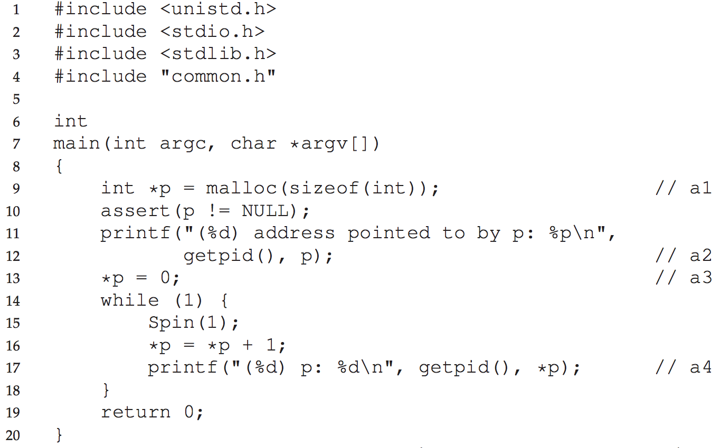
Virtualizing Memory
The model of physical memory presented by modern machines is very simple.
Memory is just an array of bytes.
To read memory, one must specify an address to be able to access the data stored there.
To write (or update) memory, one must also specify the data to be written to the given address.
Notes:
Demo:
./mem 0
ATTENTION: On a mac, this won’t work unless you disable ASLR
gcc -o mem -Wl,-no_pie mem.c -Wall
More interesting:
./mem 0 &; ./mem 0 &
Explain they have the same virtual memory location, but are independent from one another.
Mention virtual memory as an abstraction on top of physical memory. But some things you see in virtual memory are actually stored on disk (and paged in transparently).

Slide 25
Virtualizing Memory
Memory is accessed all the time when a program is running.
A program keeps all its data structures in memory.
They are accessed through various instructions, like loads and stores or other explicit instructions that access memory in doing their work.
Don’t forget that each instruction of the program is in memory too.
Thus, memory is accessed on each instruction fetch!
Notes:
Demo:
./mem 0
ATTENTION: On a mac, this won’t work unless you disable ASLR
gcc -o mem -Wl,-no_pie mem.c -Wall
More interesting:
./mem 0 &; ./mem 0 &
Explain they have the same virtual memory location, but are independent from one another.
Mention virtual memory as an abstraction on top of physical memory. But some things you see in virtual memory are actually stored on disk (and paged in transparently).

Slide 26
Virtualizing Memory
Code that Loops and Prints (mem.c)
It doesn't do much.
In fact, all it does is print the address of a program variable, enter a loop and call Spin() and print the value of that variable - forever.
Spin() repeatedly checks the time and returns after a second has passed.
Notes:
Demo:
./mem 0
ATTENTION: On a mac, this won’t work unless you disable ASLR
gcc -o mem -Wl,-no_pie mem.c -Wall
More interesting:
./mem 0 &; ./mem 0 &
Explain they have the same virtual memory location, but are independent from one another.
Mention virtual memory as an abstraction on top of physical memory. But some things you see in virtual memory are actually stored on disk (and paged in transparently).

Slide 27
Virtualizing Memory
First, it allocates some memory (line a1).
Notes:
Demo:
./mem 0
ATTENTION: On a mac, this won’t work unless you disable ASLR
gcc -o mem -Wl,-no_pie mem.c -Wall
More interesting:
./mem 0 &; ./mem 0 &
Explain they have the same virtual memory location, but are independent from one another.
Mention virtual memory as an abstraction on top of physical memory. But some things you see in virtual memory are actually stored on disk (and paged in transparently).

Slide 28
Virtualizing Memory
First, it allocates some memory (line a1).
Then, it prints out the address of the memory (a2),
Notes:
Demo:
./mem 0
ATTENTION: On a mac, this won’t work unless you disable ASLR
gcc -o mem -Wl,-no_pie mem.c -Wall
More interesting:
./mem 0 &; ./mem 0 &
Explain they have the same virtual memory location, but are independent from one another.
Mention virtual memory as an abstraction on top of physical memory. But some things you see in virtual memory are actually stored on disk (and paged in transparently).

Slide 29
Virtualizing Memory
First, it allocates some memory (line a1).
Then, it prints out the address of the memory (a2),
and then puts the number zero into the first slot of the newly allocated memory (a3).
Notes:
Demo:
./mem 0
ATTENTION: On a mac, this won’t work unless you disable ASLR
gcc -o mem -Wl,-no_pie mem.c -Wall
More interesting:
./mem 0 &; ./mem 0 &
Explain they have the same virtual memory location, but are independent from one another.
Mention virtual memory as an abstraction on top of physical memory. But some things you see in virtual memory are actually stored on disk (and paged in transparently).

Slide 30
Virtualizing Memory
Finally, it loops, delaying for a second…
Notes:
Demo:
./mem 0
ATTENTION: On a mac, this won’t work unless you disable ASLR
gcc -o mem -Wl,-no_pie mem.c -Wall
More interesting:
./mem 0 &; ./mem 0 &
Explain they have the same virtual memory location, but are independent from one another.
Mention virtual memory as an abstraction on top of physical memory. But some things you see in virtual memory are actually stored on disk (and paged in transparently).

Slide 31
Virtualizing Memory
Finally, it loops, delaying for a second…
Then, it increments the value stored at the address held in p.
Notes:
Demo:
./mem 0
ATTENTION: On a mac, this won’t work unless you disable ASLR
gcc -o mem -Wl,-no_pie mem.c -Wall
More interesting:
./mem 0 &; ./mem 0 &
Explain they have the same virtual memory location, but are independent from one another.
Mention virtual memory as an abstraction on top of physical memory. But some things you see in virtual memory are actually stored on disk (and paged in transparently).

Slide 32
Virtualizing Memory
Finally, it loops, delaying for a second…
Then, it increments the value stored at the address held in p.
With every print statement, it also prints out what is called the process identifier (the PID) of the running program.
This PID is unique per running process.
Notes:
Demo:
./mem 0
ATTENTION: On a mac, this won’t work unless you disable ASLR
gcc -o mem -Wl,-no_pie mem.c -Wall
More interesting:
./mem 0 &; ./mem 0 &
Explain they have the same virtual memory location, but are independent from one another.
Mention virtual memory as an abstraction on top of physical memory. But some things you see in virtual memory are actually stored on disk (and paged in transparently).

Slide 33
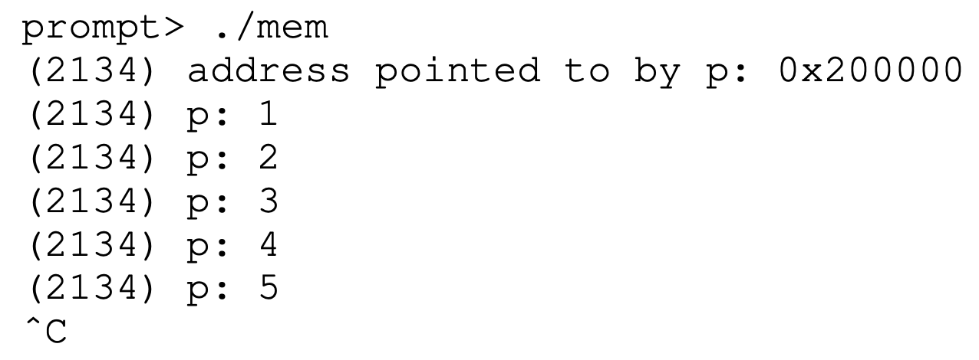
Virtualizing Memory
this first result is not too interesting…
The newly allocated memory is at address 0x200000.
Notes:
Demo:
./mem 0
ATTENTION: On a mac, this won’t work unless you disable ASLR
gcc -o mem -Wl,-no_pie mem.c -Wall
More interesting:
./mem 0 &; ./mem 0 &
Explain they have the same virtual memory location, but are independent from one another.
Mention virtual memory as an abstraction on top of physical memory. But some things you see in virtual memory are actually stored on disk (and paged in transparently).

Slide 34
Virtualizing Memory
this first result is not too interesting.
The newly allocated memory is at address 0x200000.
As the program runs, it slowly updates the value and prints out the result.
Notes:
Demo:
./mem 0
ATTENTION: On a mac, this won’t work unless you disable ASLR
gcc -o mem -Wl,-no_pie mem.c -Wall
More interesting:
./mem 0 &; ./mem 0 &
Explain they have the same virtual memory location, but are independent from one another.
Mention virtual memory as an abstraction on top of physical memory. But some things you see in virtual memory are actually stored on disk (and paged in transparently).

Slide 35
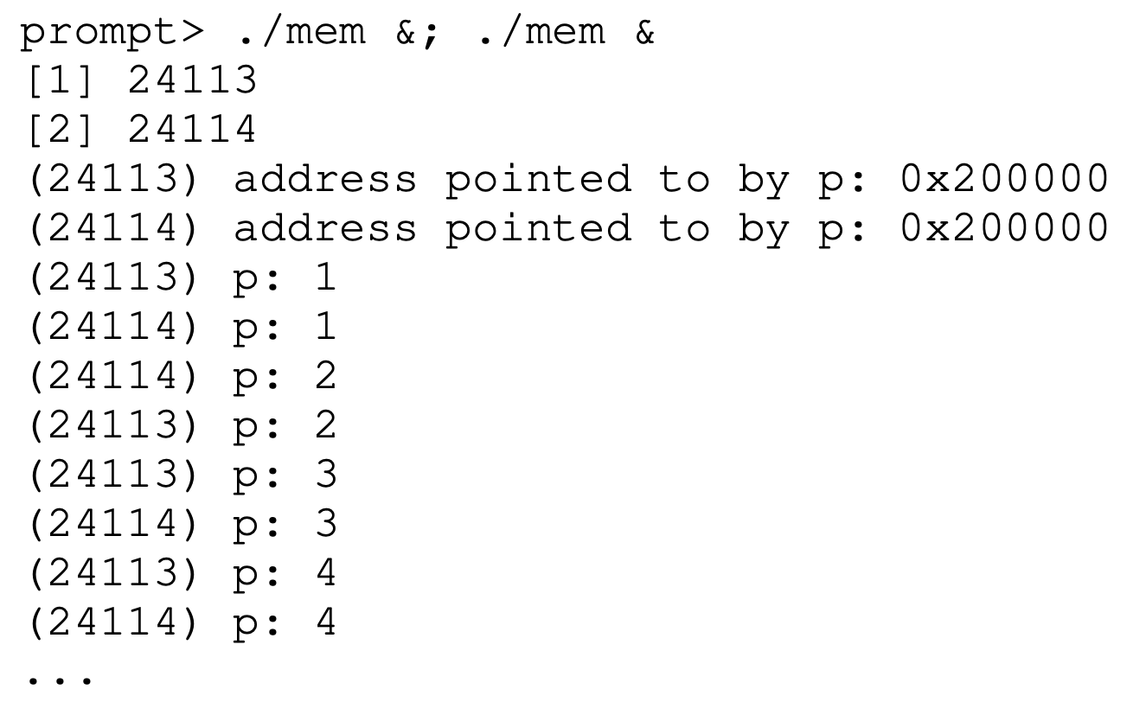
Virtualizing Memory
we again run multiple instances of this same program to see what happens.
Notes:
Demo:
./mem 0
ATTENTION: On a mac, this won’t work unless you disable ASLR
gcc -o mem -Wl,-no_pie mem.c -Wall
More interesting:
./mem 0 &; ./mem 0 &
Explain they have the same virtual memory location, but are independent from one another.
Mention virtual memory as an abstraction on top of physical memory. But some things you see in virtual memory are actually stored on disk (and paged in transparently).

Slide 36
Virtualizing Memory
we again run multiple instances of this same program to see what happens.
We see from the example that each running program has allocated memory at the same address (0x200000)
Notes:
Demo:
./mem 0
ATTENTION: On a mac, this won’t work unless you disable ASLR
gcc -o mem -Wl,-no_pie mem.c -Wall
More interesting:
./mem 0 &; ./mem 0 &
Explain they have the same virtual memory location, but are independent from one another.
Mention virtual memory as an abstraction on top of physical memory. But some things you see in virtual memory are actually stored on disk (and paged in transparently).

Slide 37
Virtualizing Memory
we again run multiple instances of this same program to see what happens.
We see from the example that each running program has allocated memory at the same address (0x200000)
yet each seems to be updating the value at 0x200000 independently!
Notes:
Demo:
./mem 0
ATTENTION: On a mac, this won’t work unless you disable ASLR
gcc -o mem -Wl,-no_pie mem.c -Wall
More interesting:
./mem 0 &; ./mem 0 &
Explain they have the same virtual memory location, but are independent from one another.
Mention virtual memory as an abstraction on top of physical memory. But some things you see in virtual memory are actually stored on disk (and paged in transparently).

Slide 38

Virtualizing Memory
It is as if each running program has its own private memory, instead of sharing the same physical memory with other running programs
Notes:
Demo:
./mem 0
ATTENTION: On a mac, this won’t work unless you disable ASLR
gcc -o mem -Wl,-no_pie mem.c -Wall
More interesting:
./mem 0 &; ./mem 0 &
Explain they have the same virtual memory location, but are independent from one another.
Mention virtual memory as an abstraction on top of physical memory. But some things you see in virtual memory are actually stored on disk (and paged in transparently).

Slide 39
Virtualizing Memory
Indeed, that is exactly what is happening here as the OS is virtualizing memory.
Each process accesses its own private virtual address space
The OS maps the virtual address space onto the physical memory of the machine.
A memory reference within one running program does not affect the address space of other processes (or the OS itself).
Each process “thinks” it has physical memory all to itself.
Reality: physical memory is a shared resource, managed by the operating system.

Slide 40
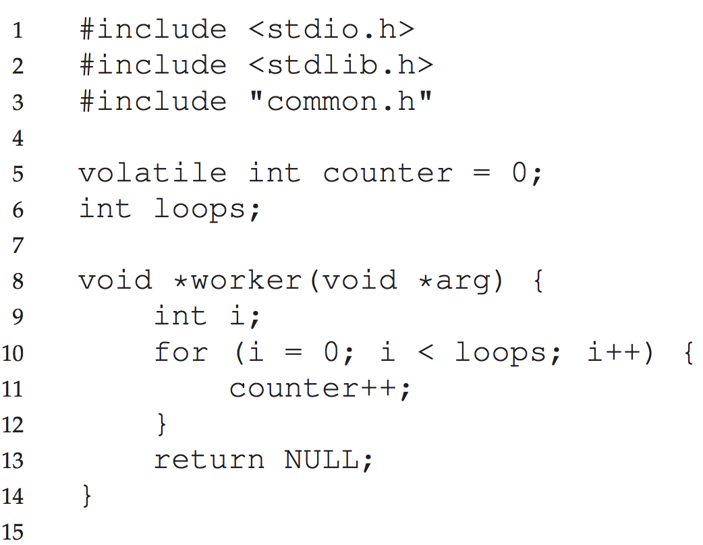
Virtualizing Execution with Concurrency
A Multi-threaded program (threads.c)
This program does something interesting…
It creates two concurrently executing threads in a single process.
Both threads share a global variable (counter) and both threads update that shared variable in two independent threads of execution.
But, problems can arise here…
This makes multi-threaded programs hard.

Slide 41
Virtualizing Execution with Concurrency
A Multi-threaded program (threads.c)
This program does something interesting…
It creates two concurrently executing threads in a single process.
Both threads share a global variable (counter) and both threads update that shared variable in two independent threads of execution.
But, problems can arise here…
This makes multi-threaded programs hard.
The volatile keyword is intended to prevent the compiler from applying any optimizations on objects that can change in ways that cannot be determined by the compiler.
Variables declared as volatile are not optimized by the compiler because their values can be changed by code outside the scope of current code at any time - multiple threads in execution concurrently!
More specifically, the compiler will make sure that any access to a volatile variable will always be fetched from memory rather than from a register.
We do this here to make it clear that a shared resource between threads can cause a race condition.

Slide 42
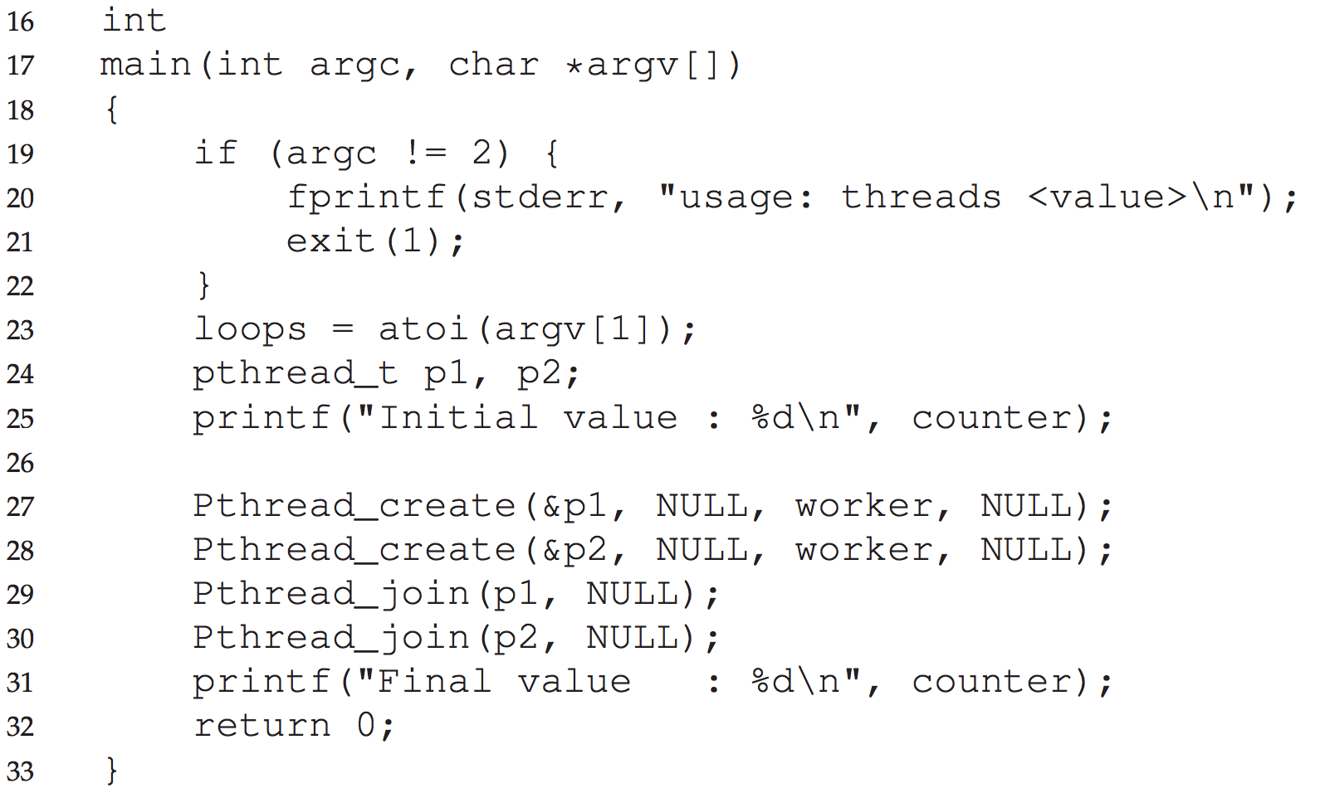
Virtualizing Execution with Concurrency
A Multi-threaded program (threads.c)
This program does something interesting…
It creates two concurrently executing threads in a single process.
Both threads share a global variable (counter) and both threads update that shared variable in two independent threads of execution.
But, problems can arise here…
This makes multi-threaded programs hard.
Notes:
Run ./threads 10000 to show the sum isn’t 20000
Also, change the counter to atomic:
_Atomic int counter = 0;
And you can get it to be 20000

Slide 43
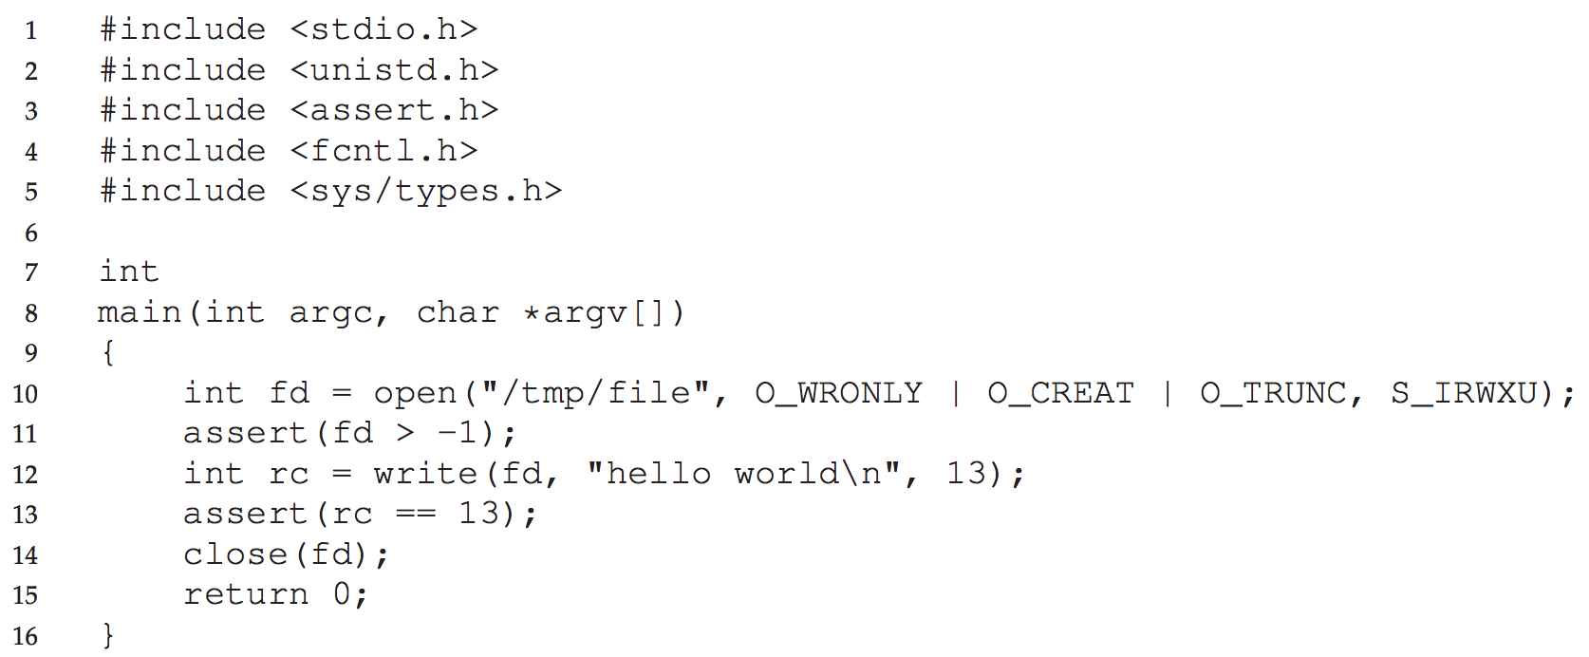
Virtualizing Storage with Persistent I/O
A Program that does I/O
(io.c)
This program writes bytes to a file.
It uses the open() system call to create a new file.
It writes 13 bytes to that file.
In system memory, data can be easily lost, as devices such as DRAM store values in a volatile manner.
We need hardware and software to be able to store data persistently; such storage is thus critical to any system as users care a great deal about their data.
Notes:
rm /tmp/file && ./io && more /tmp/file
You could reboot and it would still be there.

Slide 44

Virtualizing Storage with Persistent I/O
A Program that does I/O
(io.c)
The user application codes the program logic.
The PL API provides useful libraries and abstractions for working with "files" and "directories".
System calls work with a component of the OS called the file system.
Device drivers communicate directly to hardware that reads/writes bytes on a persistent storage medium.
Bytes are stored until overwritten.
User Application
Programming Language API
System Calls
File System
Device Drivers
Persistent Storage
Hard drive,
solid-state drives (SSD)

Slide 45


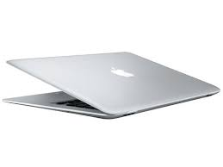
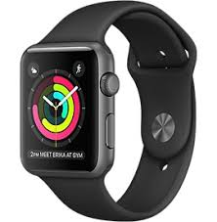
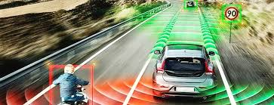
OS Design Goals
Virtualize physical resources.
Handle tricky issues related to concurrency.
Provide useful (easy to use) abstractions - very fundamental, very important!
Provide high performance, minimize overheads.
Protection and isolation.
Others: energy efficiency, security, mobility, etc. Different devices lead to different goals and optimizations.

Slide 46

The End

